Slide 1

The Influence Processes in Organisation
Power,Politics & Leadership
Module 7

Slide 2
Basic Definitions
POWER: is the ability to influence someone else.
INFLUENCE: is the process of affecting the thoughts, feelings and behaviour of others.
AUTHORITY: is the right to order others to do what you want.

Slide 3
Sources of Interpersonal Power
    All employees have a zone of indifference, the range in which they perceive influence attempts to be legitimate .
    Authority is a less useful method to
    expand the zone of indifference because it is a right.

Slide 4
Sources of Interpersonal Power
    The capacity to exert influence could be done through :
    Reward Power: is gained through providing positive outcome or preventing negative outcome.
      E.g. telling a subordinate that he has been very effective in productivity enhancement during a formal performance review.
      Used to back up legitimate power because managers are given the authority to recommend pay rises, promotions and transfers.
      Managerial reward power is expressed through delegating authority, praising and recognising performance .

Slide 5
Sources of Interpersonal Power
    Coercive Power: gained through the use of punishment or threat. It must be used carefully.
      Managers can assign undesirable tasks and give negative performance feedback.
    Legitimate Power: is gained due to one's position in the hierarchy.
      E.g Transferring an employee to an overseas assignment.
    Those types are function of vertical placement in the hierarchy.

Slide 6
Sources of Interpersonal Power
    Expert Power : the possession of specialised expertise or information which is of a high value to organisationan success.
    Expert power is acquired through the ability to solve key organisational problems.
      E.g. including a design engineer in all product review meetings because of his experience in design work.
    Referent Power: is usually gained by charismatic individual well liked & admired by others.
      E.g.emulating a senior design engineer who is widely respected throughout the company.

Slide 7
Using Power Ethically
* The Manager use of power should create the greatest good for the greatest number of people in the organisation.
* Free speech & dues of the stakeholders should not be violated.
Should preserve distributive fairness in the organisation.
Managers must communicate effectively & show respect through their words & actions

Slide 8
OBTAINING POWER by Employees
  Creating obligation in others
  Identify with powerful people
  Giving excellent performance
  Limiting access to information
  Controlling supplies and budget.
  Developing a network
  Reorganizing the job1.
  Building an image of success
  Taking risks and being creative
  Being a knowledge worker
  Manipulating rules
  Controlling personnel decisions
  Controlling financial resources
  Managing your Boss

Slide 9
OBTAINING POWER
  Building an image of success It refers to creating a good impression which projects competence and organizational commitment.
  Image-building can be done by drawing attention to one’s success and being enthusiastic to the organization.

Slide 10
OBTAINING POWER
  Creating obligation in others
  It refers to exchange of favors for others especially for those who may be in a position to help you later.
  Identifying with powerful people :
  refers to finding a mentor in the organization, usually an individual in a powerful position with the influence to positively affect the employee's career advancement.

Slide 11
OBTAINING POWER
  Giving excellent performance:
  It refers to working hard to meet the performance expectations of the organization.
  This means volunteering for difficult assignment and defending the organisation reputation.
  Being an excellent performer often means extending one’s effort in organizational areas which are not covered by the organization’s formal performance appraisal dimensions.

Slide 12
OBTAINING POWER
  Limiting access to information:
  It is one way to control scarce resources.
  Control of the flow of timely and accurate information, leads to gaining power in the management decision-making process.

Slide 13
OBTAINING POWER
  Controlling supplies and budget. Organizations try to create economies of scale by concentrating the purchasing of supplies in centralized departments.
  Other departments must then order their supplies through that department.
  To the extent that the supplies are critical, the controlling department will gain power.

Slide 14
OBTAINING POWER
  Developing a network
  It refers to building a good support system which keeps you informed about important matters in the organization.
  Not forgetting those people worked with before on a project represents an example of network-building

Slide 15
OBTAINING POWER
  Reorganizing the job:
  It refers to taking on new responsibilities, adding new objectives and creating new tasks.
  This is a strategy of “job expansion” to absorb responsibilities not covered by other employees.

Slide 16
OBTAINING POWER
  Taking risks and being creative:
  It refers to applying the principles of entrepreneurship (risk taking ) to the job.
  Employee should ensure that the risk is data based and the risks are well calculated.

Slide 17
GAINING MORE POWER
  Being a knowledge worker:
  It refers to acquiring wide expertise & knowledge to solve a given set of organizational problems.
  Manipulating rules:
  It refers to sticking closely to company policies when it is to one’s advantage, and try to change rules and procedures when that would hinder your acquisition of power.

Slide 18
GAINING MORE POWER
  Controlling personnel decisions:
  It is not limited to hiring and firing. Power can be increased by making recommendations for further training, transfer, promotion and the recruitment responsibility.
  Controlling financial resources:
  The most important means to gain and keep power.

Slide 19
GAINING MORE POWER
14- Managing your Boss: (Upward Management)
  Necessary to sustain an effective superior-subordinate relationship. Most subordinates underestimate their influence on their superior.
  Subordinates who effectively manage their bosses tend to:
  a- identify the boss’s preferred decision style
  b- identify the boss’s preferred level of formalization in dealing with subordinates
  c- periodically clarify the boss’s goals and objectives.

Slide 20
Reasons for Subunits to try to Obtain Power?
RESOURCE SCARCITY:
Limited resources increase competing for resources
2. UNCERTAINTY:
e.g. R&D , Marketing /Sales: they reduce uncertainty that gives them more power.
3. CENTRALITY
4. ABSENCE OF SUBSTITUTE

Slide 21
How Managers Play Politics?
Sustaining LINE and STAFF CONFLICT
SPONSORSHIP AND COALITION BUILDING
INSURGENCY OR RESISTING AUTHORITY
4. Whistle Blowing
behaviour occurs when the organisation’s values and practices
violate an employee’s instrumental or terminal values.

Slide 22
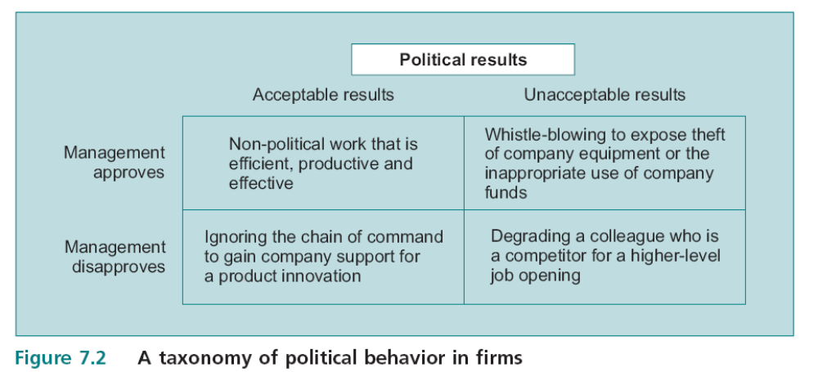
Uses and Abuses of Power:
Playing Politics

Slide 23
Looking Upward
Managing the Boss
No relationship in the organisation is more political than the one between superior and subordinate.
The superior–subordinate relationship rests on mutual dependence and the boss’s career is strongly linked to his subordinate’s career
Subordinates fail to recognise their significance in the superior–subordinate relationship and they leave the management of the relationship to their superiors.

Slide 24
Looking Upward
Managing the Boss
Faulty assumptions about the relationship:
1_The boss is omniscient and knows all the possible alternatives for solving various performance problems in the unit.
  Employees who adopt this assumption unknowingly limit their options to aid the unit through participative decision making.
2 The boss has all the information to make a decision, this one also casts the boss in the role of omnipotent decision taker.
To be more effective in managing upward, the subordinate can take some proven steps to understand his boss.

Slide 25
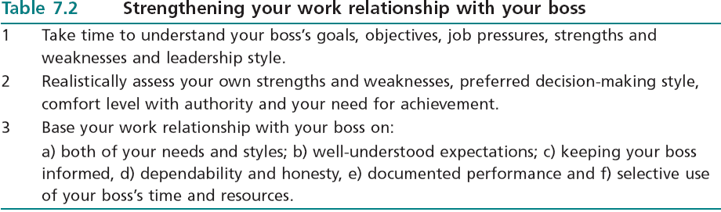
Looking Upward
Managing the Boss

Slide 26
Looking Upward
Managing the Boss
Once framed decisions, it is time to see the boss.
Most managers who are interested in developing their subordinates’ skills through delegation of authority will help a subordinate choose the best course of action.
The key is approaching the boss with alternatives which have been thoroughly thought through.
Simply asking the boss what should be done is a classic mistake made by employees who do not manage upward.

Slide 27
Leadership and Management
Leadership is the power of one individual to guide the actions of another and it is about changing the status quo.
Management is set of roles includes
  Interpersonal
  Decisional
  Informational
  The manager is responsible for the performance and productivity of subordinates in an organisational subunit.

Slide 28
Management Roles
1- Transfer of Information
2- Decision making
3- Interpersonal Relationship
Mintzberg's Roles

Slide 29
1-TRANSFER OF INFORMATION
Mintzberg's Roles
MONITOR
DISSEMINATOR
SPOKESPERSON

Slide 30
2- DECISION MAKING
Mintzberg's Roles
CREATOR/ ENTREPRENEUR
DISTURBANCE HANDLER
RESOURCE ALLOCATOR
NEGOTIATOR

Slide 31
3- INTERPERSONAL RELATIONSHIPS
Mintzberg's Roles
FIGUREHEAD
LEADER
LIAISON
(Linking Pin)

Slide 32
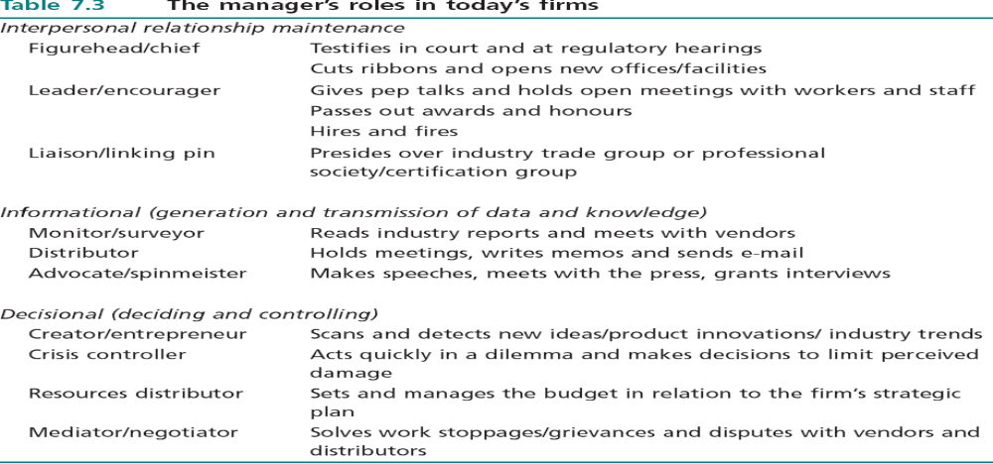
The Modern Mangers Roles

Slide 33
Effect of Downsizing and Use of Self-Directed Teams on Certain Managerial Roles
The roles of figurehead, and spokesman have nearly vanished from day to day operations.
These 2 factors have profoundly altered the emphasis on managerial roles.
Self-directed teams have simply taken over these functions once performed by middle managers.

Slide 34
Leadership Defined
Leaders are individuals who advocate change and who try new approaches to problems.
Leadership is often conceptualized as a set of behaviours or a product of the interaction of the leader’s personality and the demands of the leadership situation.
Leaders resists the status quo and proposes changes.

Slide 35
Leadership: A Conundrum of Theory
1. TRAIT
APPROACH
2. SITUATIONAL
APPROACH
3. BEHAVIOURAL
APPROACH

Slide 36
LEADERSHIP TRAITS
Leader traits are personal characteristics which include:
    Physical characteristics: height, weight, attractiveness
    Social background: Economic & social status&degree
    Intellectual abilities: verbal fluency, judgment, intelligence
    Feature of personality: Dominance, stress tolerance, creativity, aggressiveness& self confidence
    Work orientation: Initiative, desire for responsibility
    Interpersonal skills: Likeability, Diplomacy, Supportiveness

Slide 37
LEADERSHIP TRAITS
The results of trait studies have been disappointing.
A broder set of traits were used later:
    Logical Thinking traits:
    1. Putting ideas into more simple form
    2. Persuading others
    3. Explaining things in unique ways.
    Persistence traits:
    1. Treating setbacks as small mistakes
    2. Working long hours
    3. Trying to succeed against formidable odds.

Slide 38
LEADERSHIP TRAITS
    Empowerment traits:
    1. Getting people excited about goals
    2. Being energetic and enthusiastic
    3. Making subordinate believe they can achieve excellence.
    Self-Control traits:
    1. Working under heavy pressure
    2. Remaining even tempered
    3. Resisting intimidation by powerful people

Slide 39
LEADERSHIP TRAITS CRITIQUE
  Do great leaders make great situations, or
  Do great situations make great leaders?
  From the leader trait angle this means:
  “Do dominant individuals become leaders or
  do they become more dominant after have successfully occupied a leadership position?”
  If first applies then select persons with dominance trait,
  if second applies, so it is meaningless
  The trait approach does not answer this question.

Slide 40
LEADERSHIP TRAITS CRITIQUE
A crucial weakness of the trait approach is its failure to take into account the situation in which leadership is created.
Leadership is an influence process and it can not occur outside the context of interpersonal relations.
Leader traits are more closely related to who gets promoted than who is an effective leader.

Slide 41
BEHAVIOURAL SCHOOL
The key to understanding leadership effectiveness do not focus on traits but its focus is on behaviours which influence subordinate performance
The question has been refined:
Is there a dominant or preferred leadership style which is more effective than other styles?
Researchers at Ohio State University give a strong “yes” as an answer to the question.

Slide 42
BEHAVIOURAL SCHOOL
The research conclusion is that there are two behaviours:
  Initiating Structure style:
  focus on group goal attainment by stressing
    Work procedure.
    Planning.
    Assigning tasks.
    Clarifying work roles.
    Supervising subordinates .

Slide 43
BEHAVIOURAL SCHOOL
  Consideration Style :
  Consideration style focuses on self esteem issues and the cohesiveness of the work group.
  It refers to those leader behaviours which exhibit:
    Approachability
    Supportiveness
    Maintenance of high morale in the work group
    Concern for group welfare
    Maintenance of collaborative work atmosphere
  Best leadership style appears in the leader who can exhibit high consideration and high initiating structure.

Slide 44
When Do Consideration and Initiating Structure Matter?
1- When subordinates are experiencing time pressure, job ambiguity or external threat, satisfaction and performance increase under initiating structure.
2 - If the group’s task is perceived to be interesting and challenging by group members, then the need for consideration and initiating structure is reduced.
3 - When the group’s goals and task are certain, consideration promotes satisfaction and initiating structure can cause dissatisfaction. Under high task clarity, initiating structure is unnecessary .
4 - If subordinates lack job performance knowledge or their jobs are vague, consideration has less relationship than initiating with satisfaction and performance.

Slide 45
BEHAVIOURAL SCHOOL
Kurt Lewin Model
He proposed that the leadership situation was irrelevant because a leader simply approaches each situation with the same style
Autocratic Style: strong, directive, controlling and enforcing regulations & focused on outcomes
Democratic style: collaborative, interactive, responsive to needs.
Laissez fair: unwilling to accept the responsibilities of the situation

Slide 46
BEHAVIOURAL SCHOOL Critique
It is not known if leader behaviours cause the outcomes of group performance and satisfaction or conversely, they are the effects of subordinates’ behaviours which reinforce initiating structure or consideration behaviours in leaders.
The behavioural approach does not address the fundamental issue of leadership as a cause or an effect.

Slide 47
Situational Leadership Theories
The behavioural styles theory still suffers because it does not address the situation.
Situation leadership theories blend aspects of the trait and behavioural theories of leadership with specific aspects in the situation that the leader faces.
Fiedler’s Contingency Theory
House’s Path-Goal Theory
OB Mod Revisited

Slide 48
Situational Leadership Theories
Fiedler’s Contingency Theory
Fiedler’s contingency theory of leadership proposes that leader behaviour interacts with the favorableness of the situation to determine the level of group effectiveness.
Some situations are more favorable and they require different leader behaviour.

Slide 49
Situational Leadership Theories
        Fiedler’s Contingency Theory
The theory requires the assessment of the leader’s style by measuring the leader’s orientation to
his least preferred co-worker (LPC)
Leaders who describe their LPC in warm and accepting terms (high LPC Leaders) are called relationship oriented
e.g. ‘I found him hard to work with, but he still has many worthwhile qualities’

Slide 50
3. Situational Leadership Theories
        Fiedler’s Contingency Theory
Leaders who describe their LPC in negative rejecting terms (low LPC Leaders) are called task oriented
e.g. ‘I found him poor performer, dull, boring and uncreative.
The LPC score taps a personality trait called
the leader’s motivational pattern.

Slide 51
3. Situational Leadership Theories
        Fiedler’s Contingency Theory
Situational favorableness is composed of three constructs:
1. Relationship between leader and members. (most important one)
It is the quality of work group atmosphere leading to loyalty and trust.
2. Task Structure refers to goal clarity.
3. Formulation of clear performance measures .

Slide 52
How leaders
Can Chang The Situation
Relationships at Work:
1. Spend time with subordinates including socialising
2 . Request certain people for group membership or assignments
3 . Volunteer to supervise or work with troublesome group members
4 . Transfer certain group members
5 . Get additional rewards to improve morale
6 . Listen to employees’ concerns and offer personal advice

Slide 53
How leaders can change the situation that they face
Modifying Task Structure
1. Give the group creative challenges with no constraints on methods
2. Provide more standardised assignments
3. Divide the work into smaller, more specialised units
Modifying Position Power
1 . Rely on discipline to constrain troublesome team members
2 . Require all information and decisions to be reviewed by management
3 . Delegate more authority to group members (empowerment)

Slide 54
3. Situational Leadership Theories
        House’s Path-Goal Theory
        The theory is concerned with the situations which cause various leader
        behaviours to be most effective. House believes the leader’s job is the clarification of pathways between performance and the rewards they value e.g. promotion, pay increase
The behaviours which leader must develop:
Directive behaviours: setting performance standards
Supportive behaviours: friendly, caring and considerate
Participative behaviours: using subordinate ideas
Achievement oriented behaviour: setting goals

Slide 55
House’s Path-Goal Theory
The path goal theory focuses on two aspects of the leadership situation.
1- it looks at the subordinates’ task abilities and need for achievement.
2- it looks at the environmental factors of task clarity, routineness and challenge.
The leader must match his behaviour to the interplay of subordinate characteristics and environmental factors.

Slide 56
Leader Reward and Punishment Behaviour: OB Mod Revisited
1 - Performance contingent reward behaviour:
The extent to which a leader uses positive reinforcers, such as praise, recognition and affirmation of successful performance, contingent on high subordinate effectiveness.
2 - Contingent punishment behaviour:
The extent to which a leader uses discipline and punitive outcomes, such as reprimands and disapproval, contingent on ineffective subordinate performance on the job.

Slide 57
Leader Reward and Punishment Behaviour: OB Mod Revisited
3 - Non contingent reward behaviour:
The extent to which a leader rewards subordinate, regardless of how well the subordinate performs on the job.
4 - Non contingent punishment behaviour:
The extent to which a leader uses punitive means and reprimands,
The leader’s use of non performance contingent
punishment behaviour will undermine his position the fastest.

Slide 58
Entrepreneurs
Entrepreneurship is the creation of wealth by assuming risk through equity, time, or career commitment to add value to a product or service.
Entrepreneurs are special types of leaders who create wealth by assuming risk.
Entrepreneurship consists of skills which can be learned.

Slide 59
Entrepreneurial Behaviour
Entrepreneurs tend to :
Spot opportunities
Radically change the firm
Exhibit self-confidence
Believe in firm’s capabilities
Keep salaries low and use incentives to retain talents
Use bonuses at individual and team levels

Slide 60
Entrepreneurs
They differ from administrators in their orientation to strategy, opportunity exploitation, decision making, resource allocation and reward practices.
A crucial feature of entrepreneurial behaviour is a ‘bias for action, high innovative activities aimed at profits.
They assume risk based on careful planning.

Slide 61
Entrepreneurs
Evidence indicates that entrepreneurial traits are acquired and not inherited.
Being single minded is more important than being rich when starting a business.
Hard work and urgency were very important instrumental for success

Slide 62
Entrepreneurs
Entrepreneurship is a process of dissatisfaction with the status quo ,opportunity recognition followed by a plan to exploit the opportunity
Entrepreneurs can be found in all organisational settings.
The defining characteristics of entrepreneurs are the abilities to detect business opportunities and to exploit those opportunities to create a rapidly growing enterprise.

Slide 63
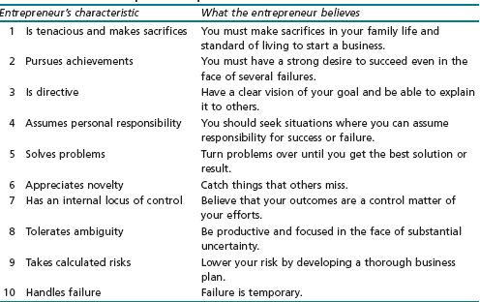
The Entrepreneurial Profile

Slide 64
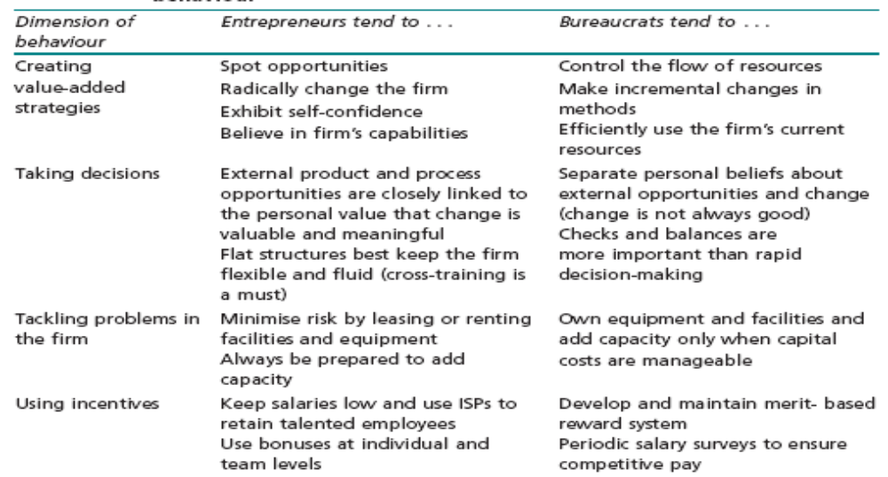
Differentiating Entrepreneurial from Administrative Behavior

Slide 65
Myths About Entrepreneurs
1 Entrepreneurs are doers, not thinkers.
2 Entrepreneurs are born and not made.
3 All you need is money.
4 All you need is luck.

Slide 66
Encouraging Entrepreneurial Behaviour In-House
Large companies are encouraging and rewarding employees who become entrepreneurs
Each innovation in an organisation begins with an idea champion who is an employee generates an idea and retains responsibility for developing that idea in the organisation

Slide 67
Entrepreneurs
Entrepreneurial behaviour can be learned by employees.
‘The organisation must create the roles of:
1) Idea champion
2) Sponsor
3) Godfather
to ensure a culture that encourages entrepreneurship.

Slide 68
Encouraging Entrepreneurial Behaviour In-House
For each idea champion, there must also be a sponsor nurtures the new concept and applies organisational resources to the development of the idea.
The godfather makes resources available, gets people working together and builds coalitions which help convert non believers.

Slide 69
Greenhouses
Organisations must also protect creative groups from organisational bureaucracy by creating greenhouses’ or ‘reservations
These work units are different from other parts of the organisation.
They are often physically removed from the rest of the firm.
They take on unique characteristics which reflect the work habits of their employees.

